Slide 1

The Nursing Education Xchange (NEXus): Promoting a Community of Learners
Jeanette McNeill, Professor Emerita
University of Northern Colorado
Anne Boerner, NEXus Project Director
NEXus – The Nursing Education Xchange

Slide 2
Conflicts of Interest and Disclosures:
Neither the planner(s) or presenter (s) indicated that they have any real or perceived vested interest that relate to this presentation.

Slide 3
OBJECTIVES: Through participation in this presentation, attendees will have the opportunity to:
  Describe the establishment and maintenance of a multi university network collaboration for sharing resources and student participation in diverse course offerings.
  Examine best practices in collaborating among a community of faculty and students.
  Discuss with fellow educators their own experiences in sharing resources.

Slide 4

The Nursing Education Xchange
WHY
► Address nursing and nurse educator shortage
► Facilitate doctoral students in completing programs via distance learning
► Collaborate across organizational systems to impact change in education and practice
MEETING THE GOALS….
► Reduce cost of creating online courses
► Increase course offerings for students
► Overcome administrative barriers of shared courses
► Collaborate to promote change in education and practice
TODAY
MEMBERS
GRADUATES
SEATS
(total all years)
ANNUAL
COURSES
16
250
Over
1,000
Over
300

Slide 5

Background
  Historical overview
  Operating processes
This Photo by Unknown Author is licensed under CC BY-NC-ND

Slide 6


The Community

Slide 7
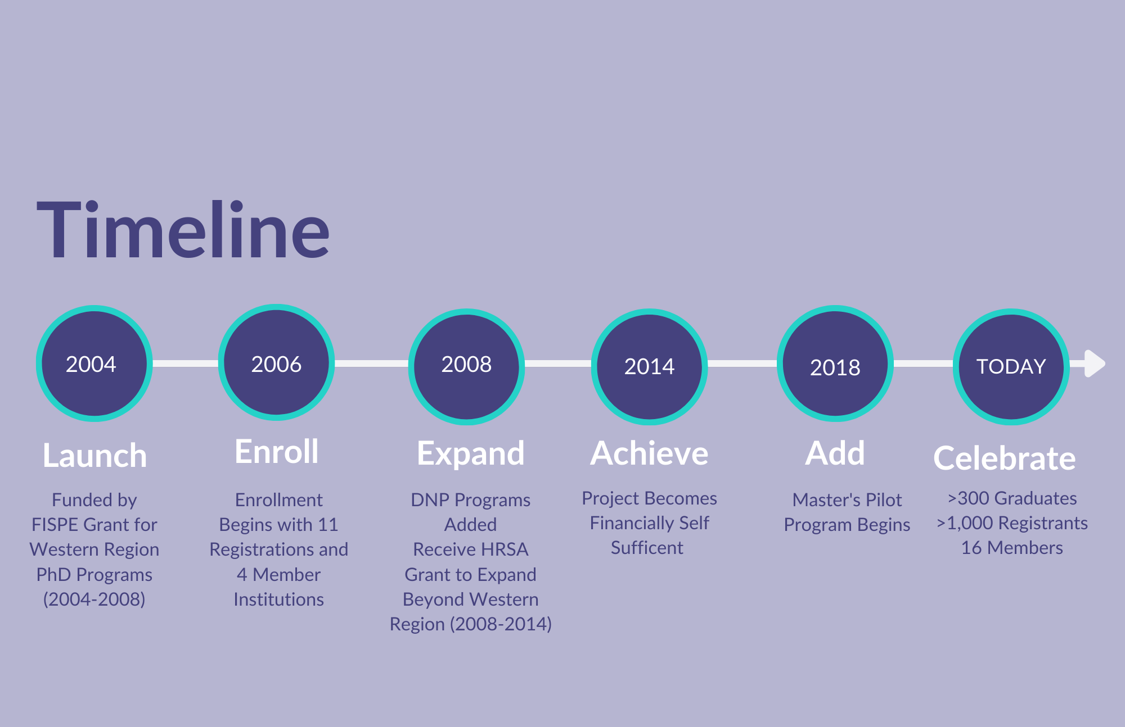

Slide 8
Pair and share---turn to your neighbor and…..
Share any past or current experiences you have had participating in course sharing and/or consortiums….
What made the partnership work?

Slide 9
Organizational Chart
Academic Collaborator
Institutions
Executive Committee
Cluster Faculty
Lead Organization
(WIN)
Academic Affiliate Institutions
(none currently)
► Executive Committee = representative from each Academic Collaborator
► Officers elected to Committee
► Each Collaborator identifies a Faculty Coordinator + Campus Staff Coordinator

Slide 10

Key Foundation Documents
Guiding Principles:
  Document outlining philosophical approach and principles underlying the collaborative
Memorandum of Understanding:
  The agreement signed by campus deans and administrators
Bylaws, Policies, and Procedures:
  The operating procedures that provide structure to the collaborative

Slide 11
Additional Supporting Committees
In addition to Executive Committee:
Sustainability Committee (Officers)
Evaluation Committee
DNP Committee
Student Advisory Committee
Ad Hoc as needed
Past Committees included Database and Emerging Clusters
*DNP Specific Descriptions

Slide 12
Members
Academic Collaborator = Teaches and sends Home students
Academic Affiliate = Only sends Home students.
Current Members
Arizona State University
Loma Linda University
Oregon Health and Science University*
The Ohio State University
The University of Iowa
The University of Oklahoma
The University of Texas at Tyler
University of Colorado Denver*
University of Hawaii at Manoa
University of Kansas
University of Nevada Las Vegas
University of New Mexico
University of Northern Colorado*
University of Utah*
Virginia Commonwealth University
Washington State University
*Founding Member

Slide 13
How NEXus works
MEMBER INSTITUTIONS:
  Pay annual dues to participate
  Facilitate paperwork
  Collect tuition and share between the Home and Teaching institutions, and NEXus Office.
STUDENTS:
  From member institutions choose from >250 online graduate courses https://winnexus.org/
  Use their institutions’ process to request to enroll in selected course
  Earn credits toward their own university’s program
  May take advantage of their existing financial aid
  Pay a common tuition rate

Slide 14
NEXus Language
TEACH = University offering the course
HOME = Institution sending the student
Campus Staff Coordinator (CSC) = Administrative Coordinator on Campus for NEXus

Slide 15

How Students Enroll
Student selects Course with Advisor Approval and submits Registration form to Home Coordinator
Home Coordinator requests the seat electronically from Teaching Institution Coordinator and institution grants seats.
Student submits all other paperwork to Teach including financial aid if applicable. Teach coordinates Admission and Enrollment.
Student follows Teach and Home Transcript process.

Slide 16
How the Financials Work
Member institutions pay annual dues
$5,000 or $6,000 depending on level/programs
Students pay a common tuition rate
$865/credit
Tuition collected by Teaching institution
and split three ways
2019-20
MEMBER AVERAGES
COURSE OFFERINGS
16
STUDENT ENROLLMENTS
Teach 6 +
Send 6
Tuition Collected by Teach
Teach 75%
NEXus 15%*
Home 10%*
SHARE
FORMULA
MEMBER INCOME
$12,961

Slide 17

For Universities: Benefits + ROI
BENEFITS
Fill seats in specialized courses
Offer a broader range of courses w/expert faculty
Reach a larger diverse group of students
Assist students in timely progression and retention
Ease faculty workload from independent study
Respond to emergencies quickly
RETURN ON INVESTMENT
Generate additional income
Save on instructor salary (estimated at $15,900)
Save on course development costs
(estimated at $6,900)
2019-20
TOTAL TUITION GENERATED
$259,215
303 TOTAL CREDITS
84 DISTINCT COURSES
INSTITUTION INCOME
$220,334
ESTIMATED FACULTY SALARY COST SAVINGS
$1,033,200
@ $15,900 EACH
ESTIMATED COURSE DEVELOPMENT SAVINGS
$445,200
@6,900 EACH

Slide 18
What about costs! ?
What are some strategies your faculty group or institutions have used to bring about cost savings ?

Slide 19


Course Offerings
GROWTH OVER TIME
►25 to 85/Term ►4 to 15 Clusters

Slide 20
Current Clusters/Areas of Study
Advance Nursing Practice*
Children, Parents and Family
Chronic and Disabling Conditions and Palliative Care
Diverse and Vulnerable Populations
Ethics*
Interprofessional Collaboration*
Gerontology and Geriatric Nursing
Non-Nursing Courses
Nursing Education
Nursing Knowledge Development: Theory, Philosophy, and Science
Research Methodology (Mixed Methods, Qualitative and Quantitative Research Methods)
Scientific Underpinnings for Advanced Nursing Practice*
Scholarship and Writing
Special Topics
Systems, Leadership, Informatics and Policy
*DNP Specific Descriptions

Slide 21

Measuring Outcomes
For each university
For the individual student
For the organizational framework
For nursing education
This Photo by Unknown Author is licensed under CC BY-NC

Slide 22
Historical Enrollments
STUDENTS | 2006-07 | 2007-08 | 2008-09 | 2009-10 | 2010-11 | 2011-12 | 2012-13 | 2013-14 | 2014-15 | 2015-16 | 2016-17 | 2017-18 | 2018-19 | 2019-20 | 2020-21 | TOTAL
PhD | 10 | 6 | 18 | 21 | 49 | 48 | 59 | 68 | 64 | 59 | 56 | 33 | 43 | 76 | 38 | 648
DNP | 0 | 0 | 0 | 1 | 10 | 17 | 10 | 20 | 36 | 41 | 20 | 15 | 24 | 19 | 13 | 226
Masters |  |  |  |  |  |  |  | 1 |  | 7 |  |  |  |  | 1 | 9
TOTALS | 10 | 6 | 18 | 23 | 59 | 65 | 69 | 89 | 102 | 107 | 76 | 47 | 67 | 96 | 52 | 886

Slide 23
Graduation Data
321 Graduates have taken a NEXus Course

Slide 24
Best Practices: Organization evaluation practices
Formative and summative approaches used to
  Evaluate the effectiveness of the courses,
  Evaluate the exchange itself, and
  Assess student/faculty satisfaction.
Course evaluations are:
  Important indicators of effectiveness;
  Are administered to participating students/faculty and reviewed periodically

Slide 25
Evaluation of Course Offerings
► Each term students and faculty are sent NEXus surveys to complete.
Evaluations are overseen by a NEXus Evaluation Committee that includes at least one Executive Committee Member, a Campus Staff Coordinator and the NEXus Project Director.
Results are summarized and shared with members
Individual institutions receive feedback if specified in an evaluation

Slide 26
Student Course Evaluations
Thirty-eight questions include areas of:
Demographics
Degree program
Career plans
NEXus enrollment and course experiences.
Three questions and results follow:

Slide 27
Student Course Evaluations
Fall 2014 to Fall 2020
QUESTION: To what extent did the array of courses offered by NEXus meet your current need(s)?
85% Reported being able to take a course in their degree plan
"5" indicates the courses were exceptional in meeting student’s needs, and "1" indicates the courses did not meet student’s needs.

Slide 28
Student Course Evaluations
Fall 2018 to Fall 2020
SUMMARY OF OTHER RESPONSES
Topic of Interest/Research | 10 | To get ahead of the course load for the fall semester. | 1
Sequence or Time of Offering | 6 | To experience a different perspective from another institution | 1
Summer Studies | 3 | An external course required for program | 1
Elective for PhD program | 1
Both of the above (Not offered and Faculty Member Teaching) | 1

Slide 29
Student Course Evaluations
QUESTION: Did the NEXus course facilitate your remaining “on time” in your program of study?
96% Answered Yes

Slide 30
Student Course Evaluations
    “I appreciated the diversity and exposure to other doctoral teaching methods”
“Networking with faculty at other
schools really helped me grow”
“Meeting my professors was a great
networking opportunity…she
offered to continue working with me
throughout my PhD program.”

Slide 31

University/Faculty Feedback:
Highlights Are Diversity and Networking
    “Nexus is crucial to the success of our program”
    “Having this more widely distributed group of students adds depth and value”
    “Having NEXus students in the courses adds rich diversity of thought”

Slide 32
University Feedback
One executive committee member commented….
    “This collaboration is invaluable, both from the standpoint of our students, as well as related to the interactions among programs of nursing education… We are stronger together!”

Slide 33
One more question…..pair and share…..
What road blocks to course sharing have you experienced?

Slide 34
CONCLUSIONS:
  Continuing evaluation of educational networks informs best organizational practices,
  Network collaborations, such as NEXus, demonstrate that academic partnerships enhance resilience-- of educators, institutions and students.
  Programs, such as NEXus, facilitate the preparation of clinical and nursing educational leaders.

Slide 35
Questions

Slide 36
References/Resources
Resources:
www.winnexus.org
  The Benefits of Joining NEXus
  Real Time Catalog of Course Offerings
  How to Enroll for Students
  Campus Contacts
  Cluster Descriptions
  Member Packet Information
  2019-20 Annual Course Listing and Report
  Quick Handout: Overview of NEXus
References for Faculty Salary and Course Development Costs:
American Association of Colleges of Nursing. Table 76, Associate Professor Rank (Total all Institutions and Doctoral Degree Level). 2019-2020 Salaries of Instructional and Administrative Nursing in Baccalaureate and Graduate Programs in Nursing, Washington, DC.
American Association of University Professors. Survey Report Tables 8 &9. Annual Report on the Economic Status of the Profession, 2019-20
Chapman, B. (2010). How Long Does it Take to Create Learning? [Research Study]. Development Ratios - Summary Table. Published by Chapman Alliance LLC. from www.chapmanalliance.com
Defelice, Robyn A. "How Long Does It Take to Develop Training? New Question, New Answers." Web blog post ATD Association for Talent Development. ATD Global. 13 Jan. 2021. Web. 25 Feb. 2021.
Freeman, Lee A. "Instructor Time Requirements to Develop and Teach Online Courses." Web post Online Journal of Distance Learning Administration, Volume XVIII, Number I. University of West Georgia, Distance Education Center, Spring 2015. 25 Feb. 2021.
Safai, Alan. "How long does it take to develop an online course?" Web blog post eLearning Blog. The University of Texas at Dallas, 8 Apr. 2019. Web. 25 Feb. 2021.

